Slide 1
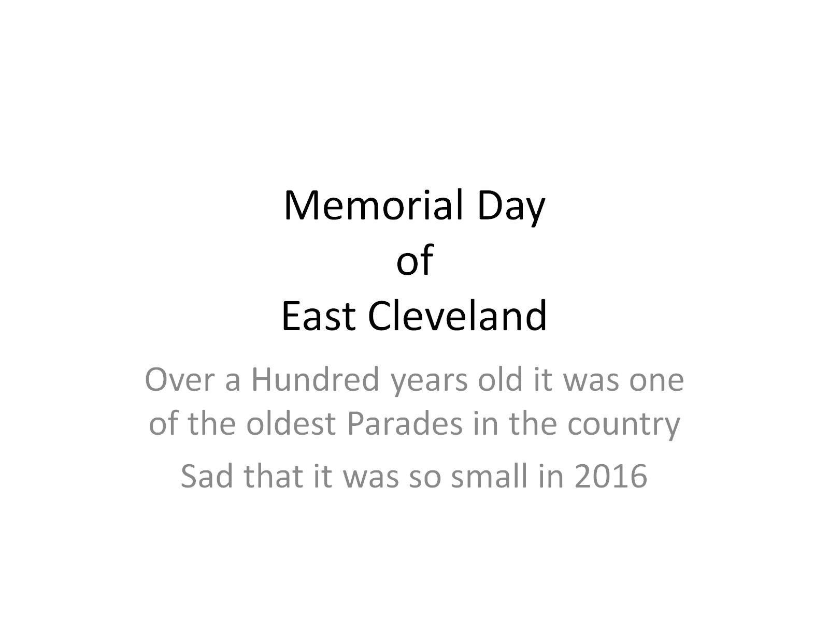
Memorial Day of
East Cleveland

Slide 2
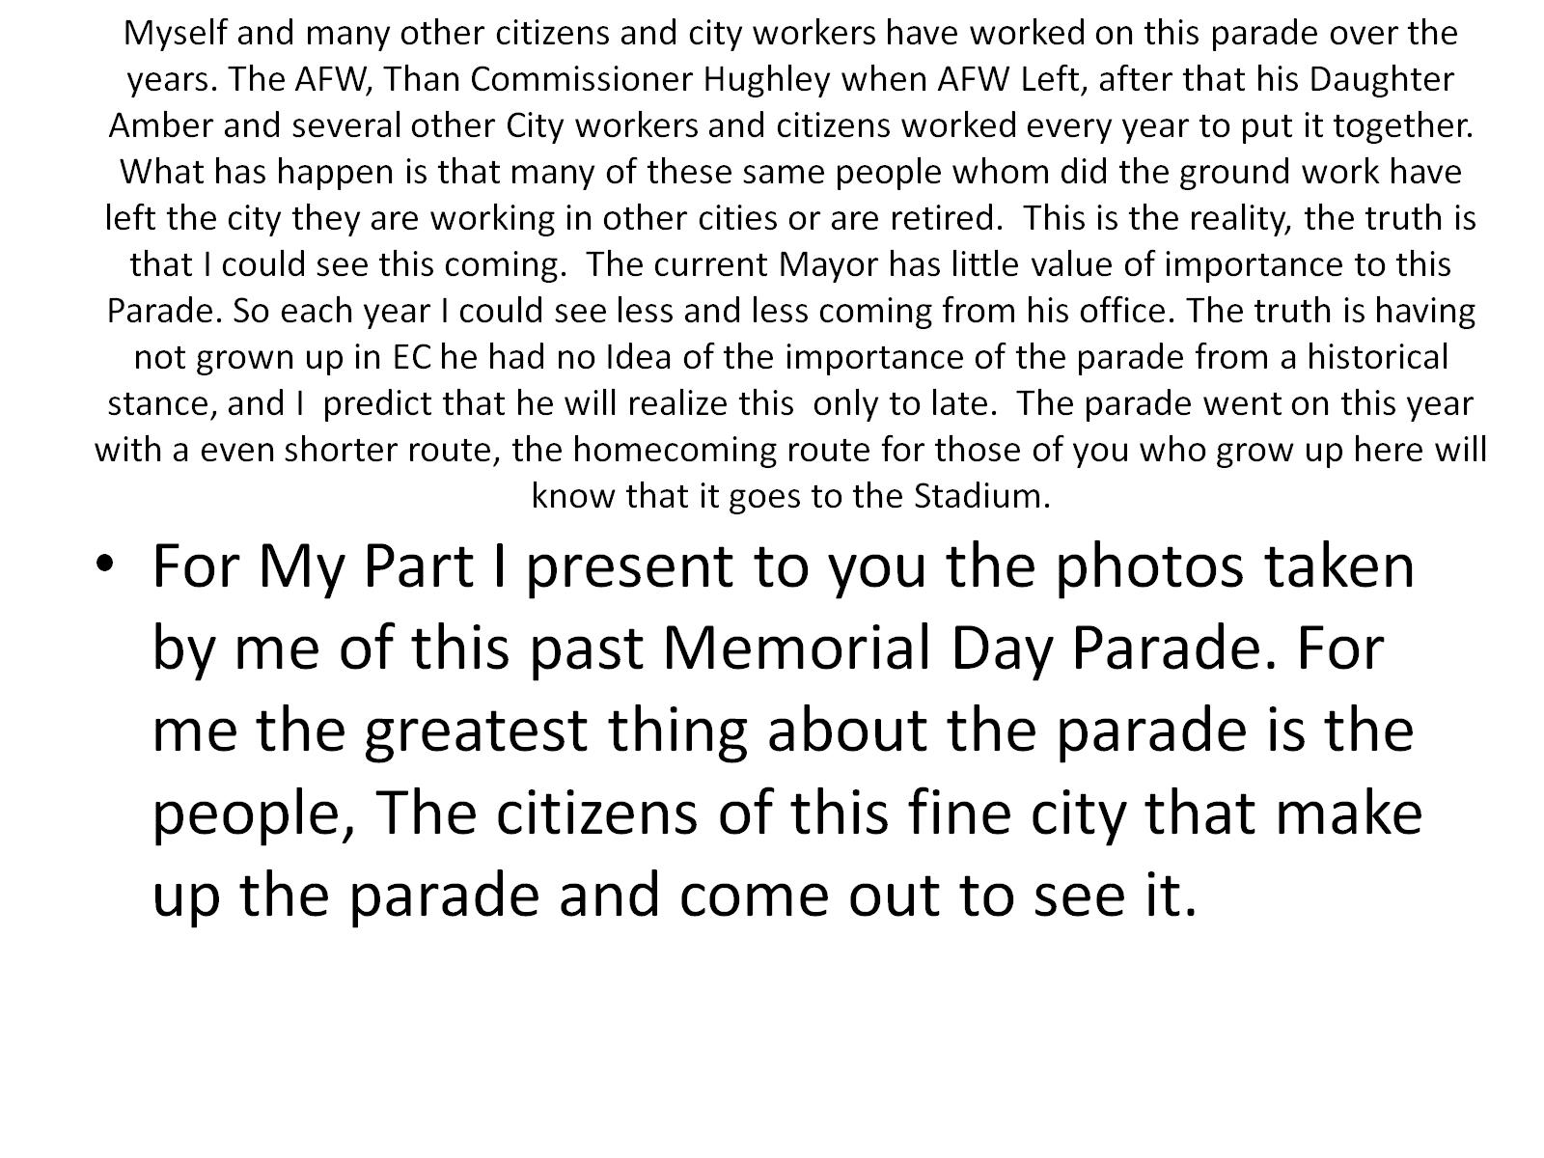
Myself and many other citizens and city workers have worked on this parade over the years. The AFW, Than Commissioner Hughley when AFW Left, after that his Daughter Amber and several other City workers and citizens worked every year to put it together. What has happen is that many of these same people whom did the ground work have left the city they are working in other cities or are retired. This is the reality, the truth is that I could see this coming. The current Mayor has little value of importance to this Parade. So each year I could see less and less coming from his office. The truth is having not grown up in EC he had no Idea of the importance of the parade from a historical stance, and I predict that he will realize this only to late. The parade went on this year with a even shorter route, the homecoming route for those of you who grow up here will know that it goes to the Stadium.

Slide 3
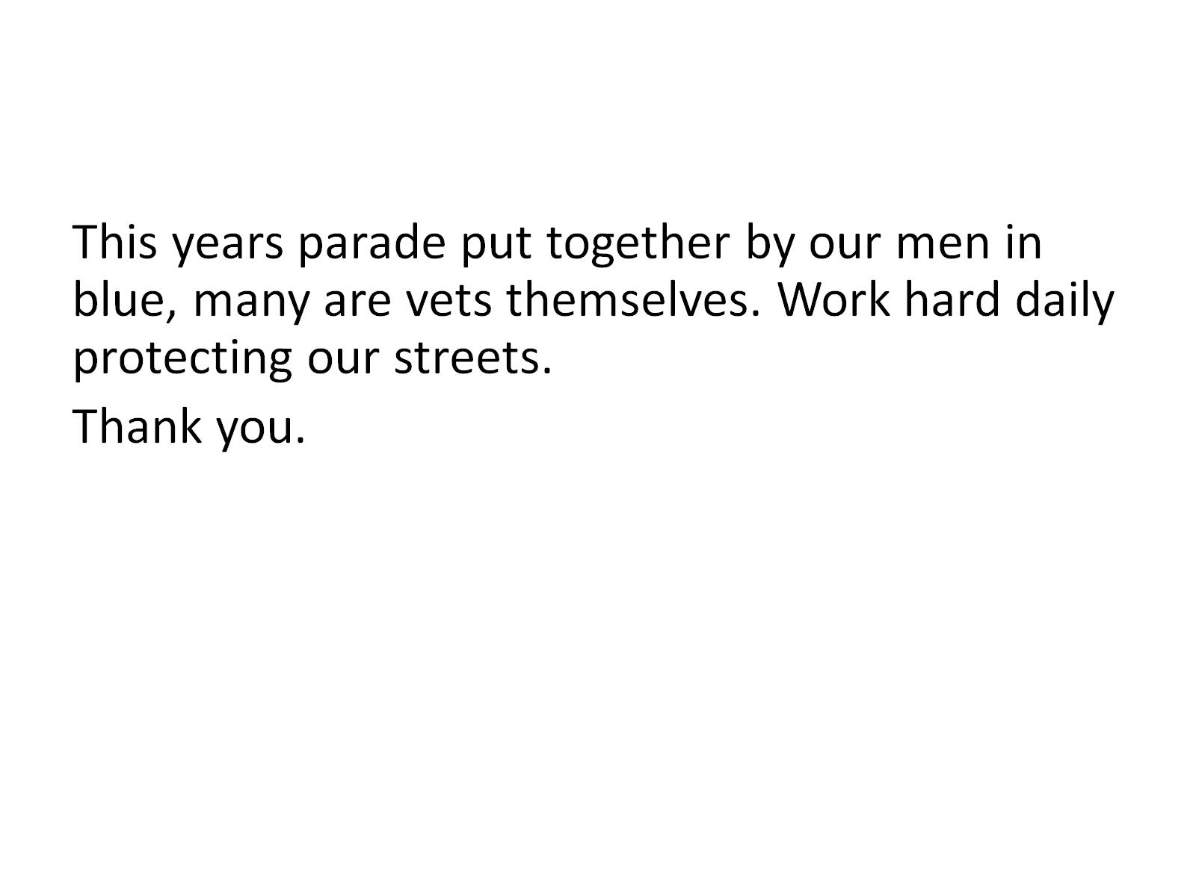

Slide 4
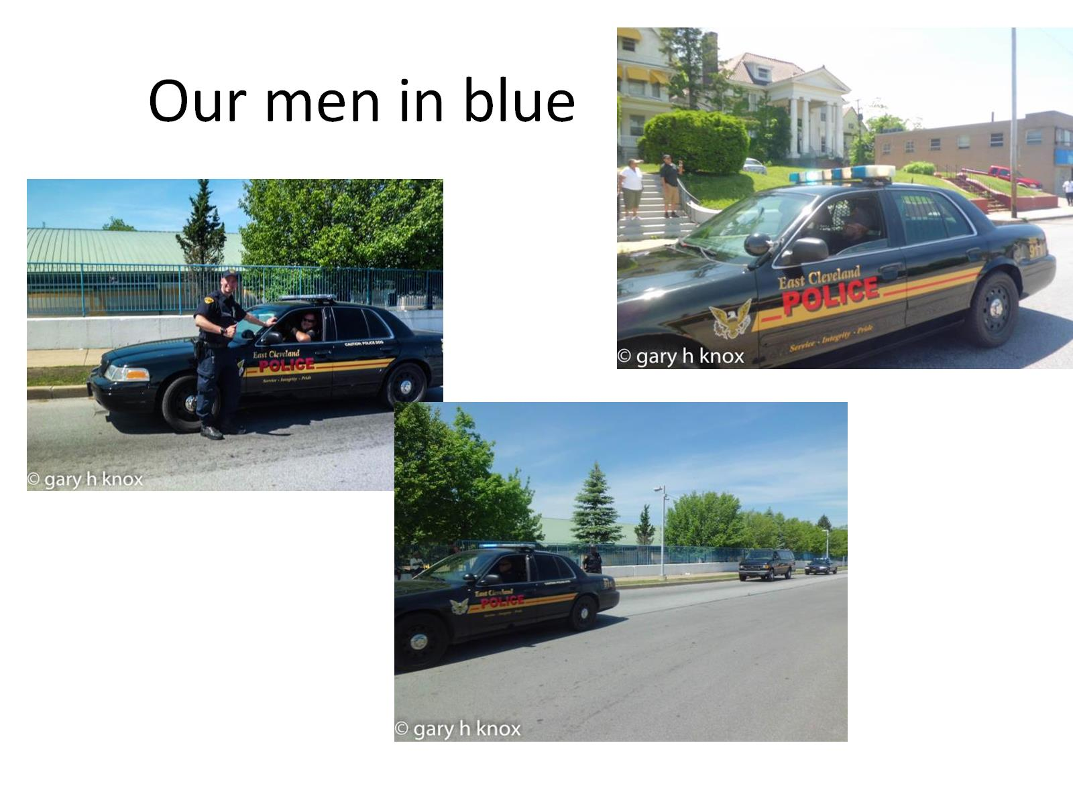
Our men in blue

Slide 5
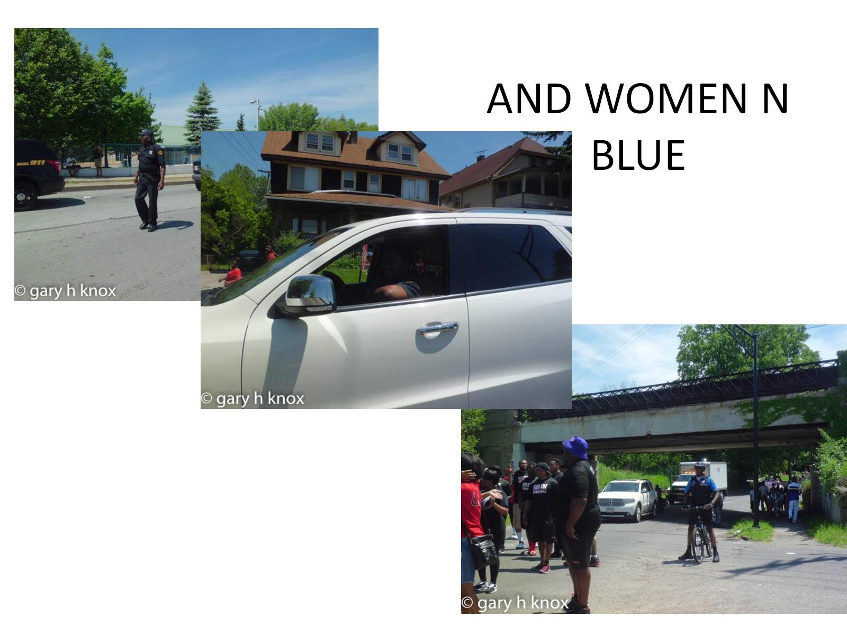
AND WOMEN N BLUE

Slide 6
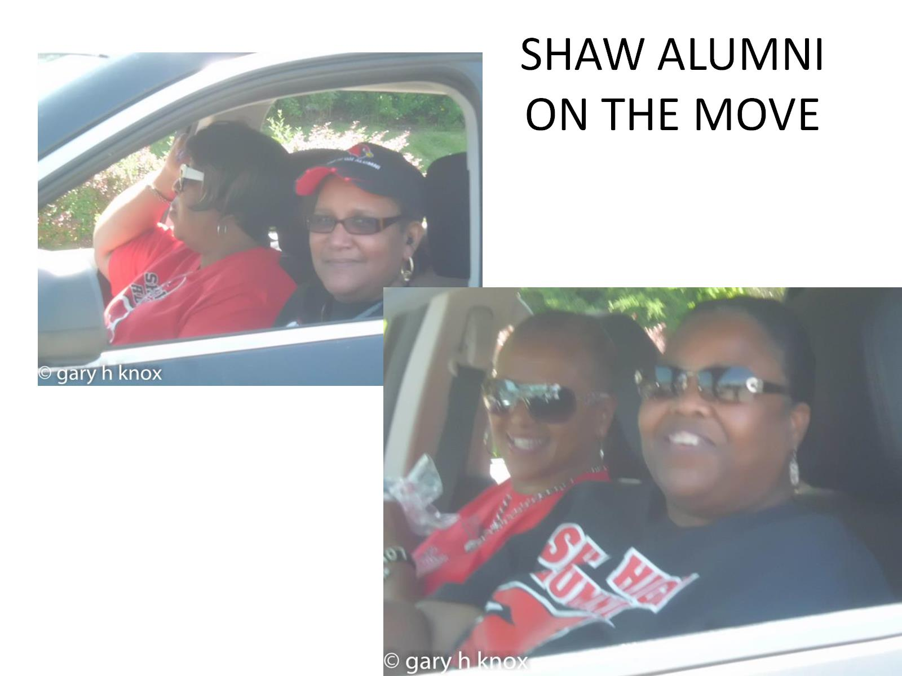
SHAW ALUMNI ON THE MOVE

Slide 7
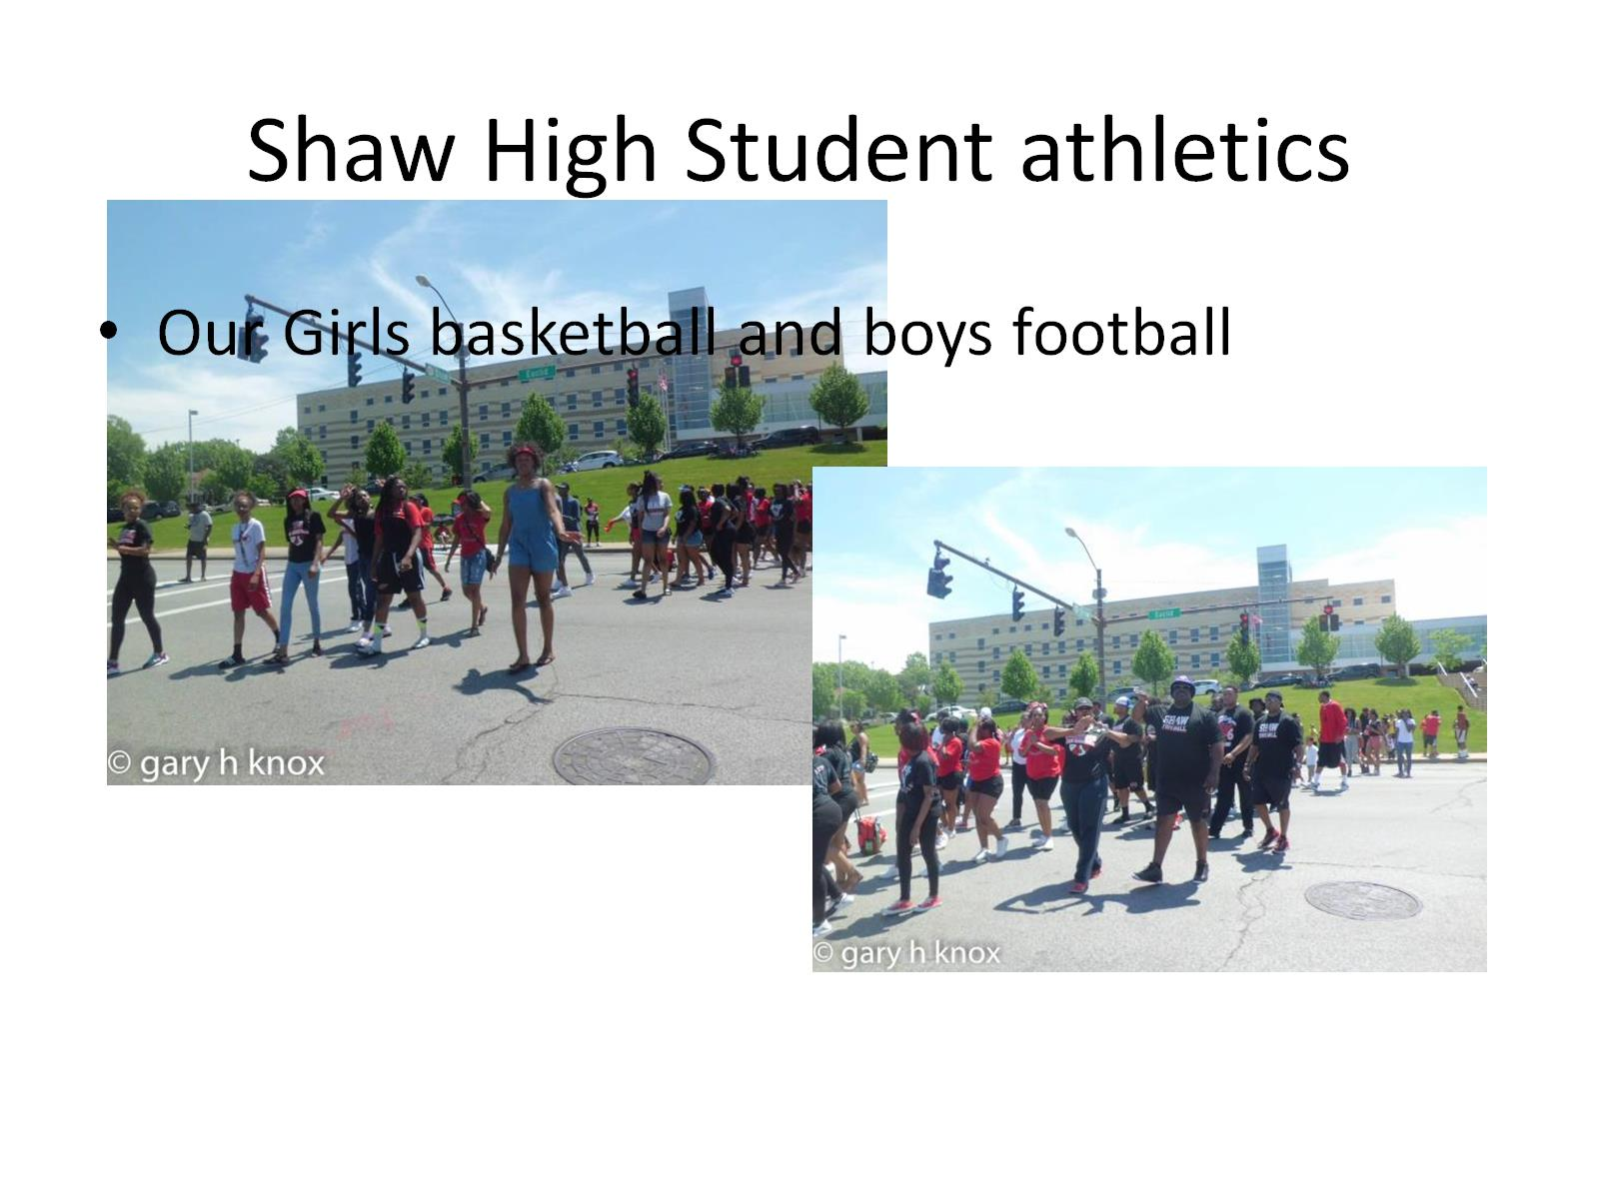
Shaw High Student athletics

Slide 8
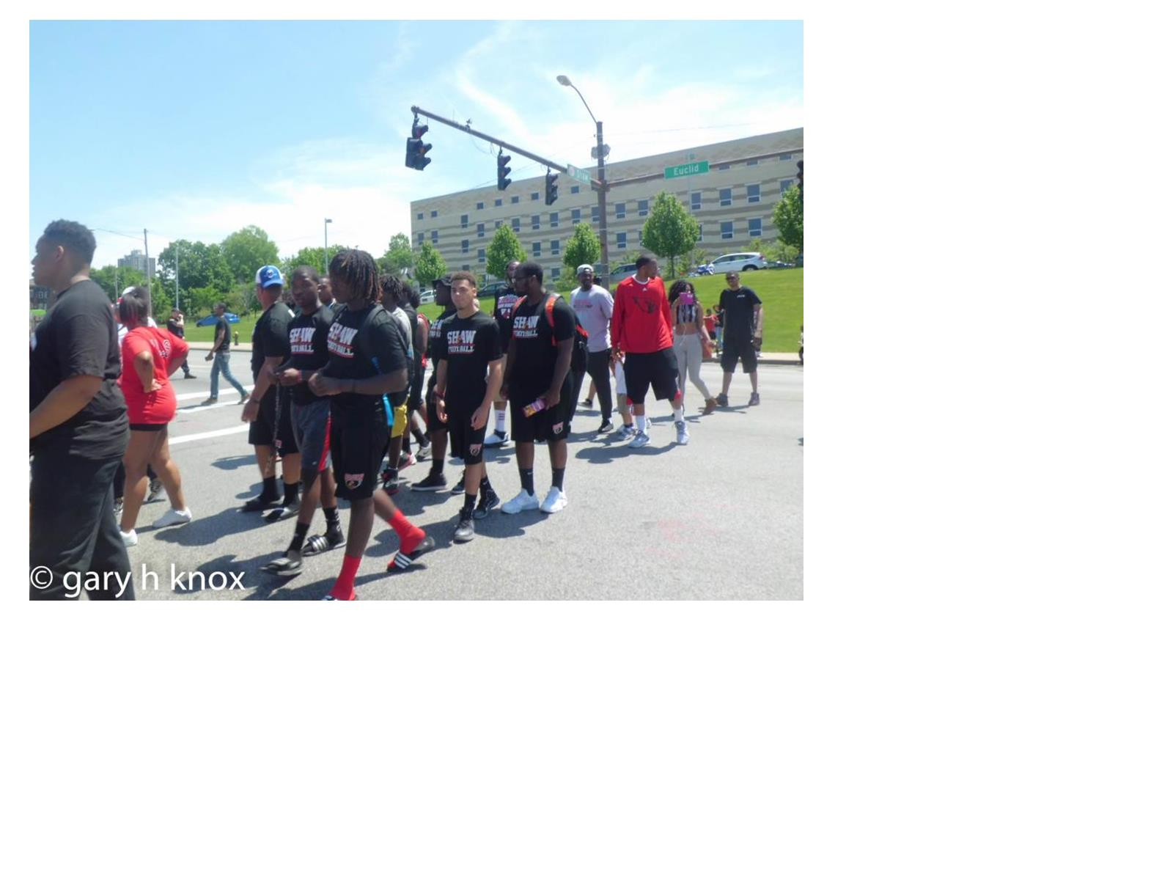

Slide 9
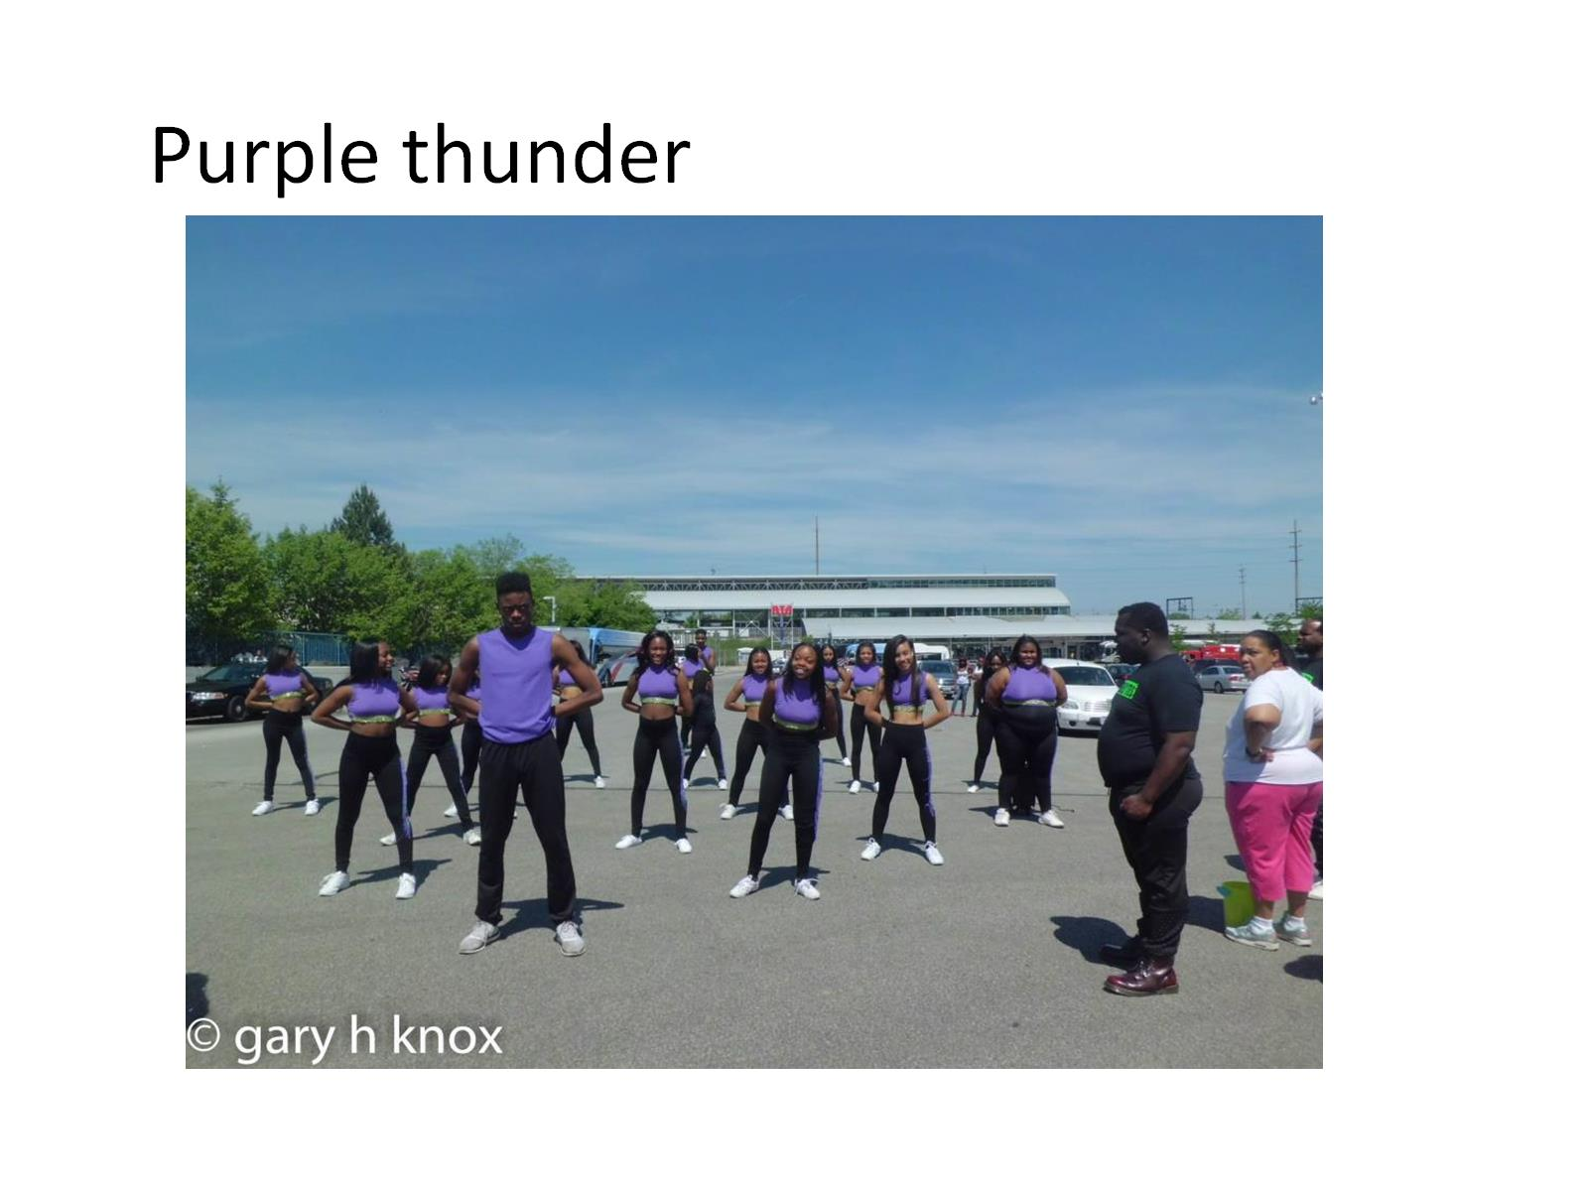

Slide 10
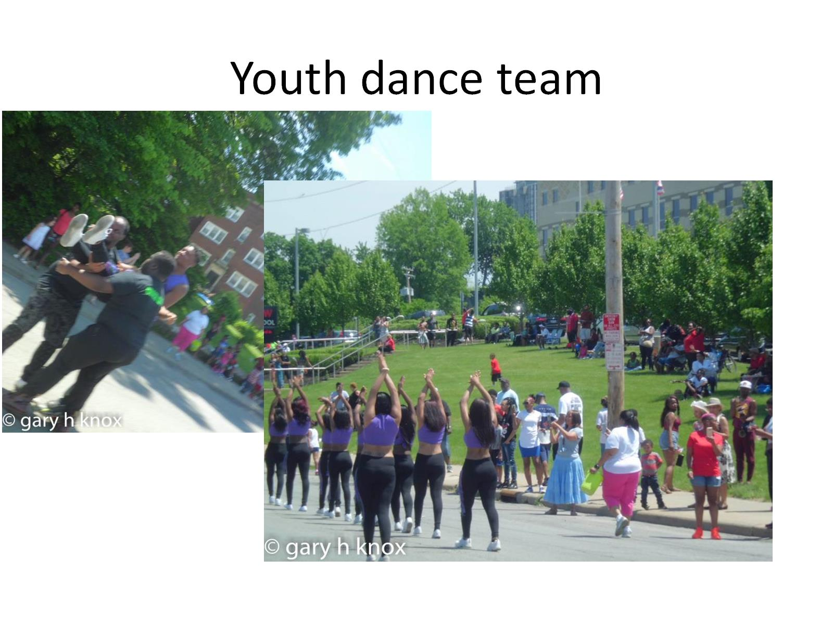
Youth dance team

Slide 11
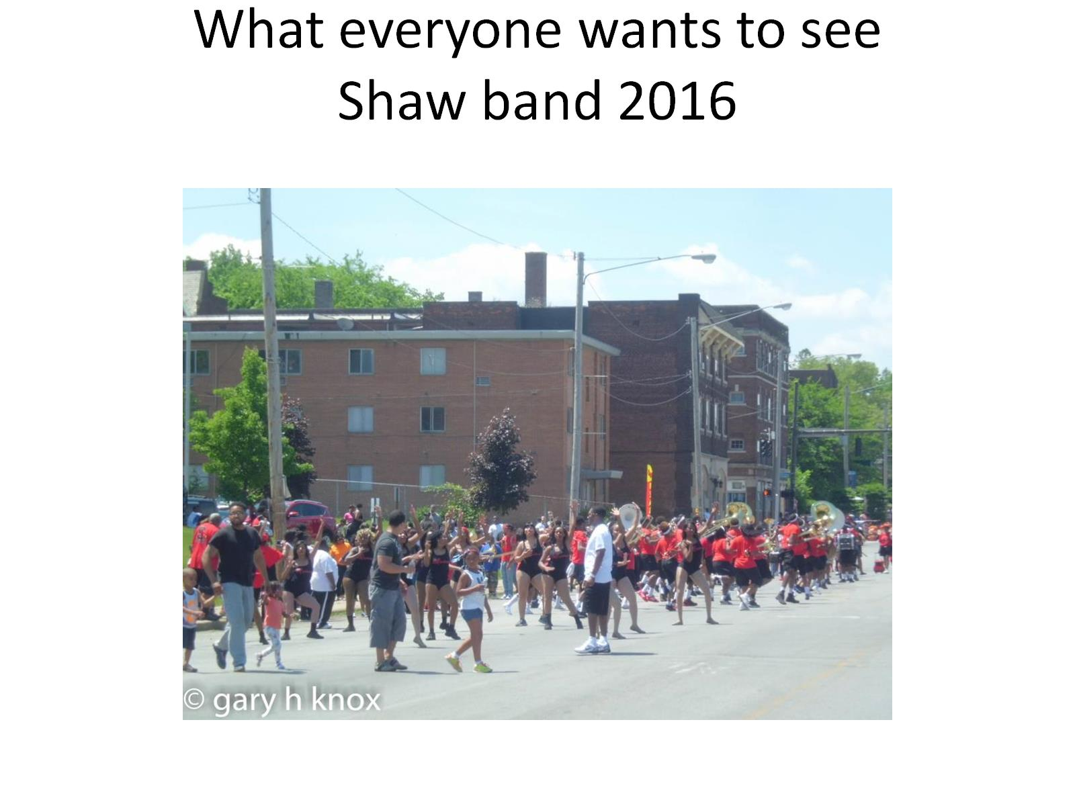
What everyone wants to see
Shaw band 2016

Slide 12
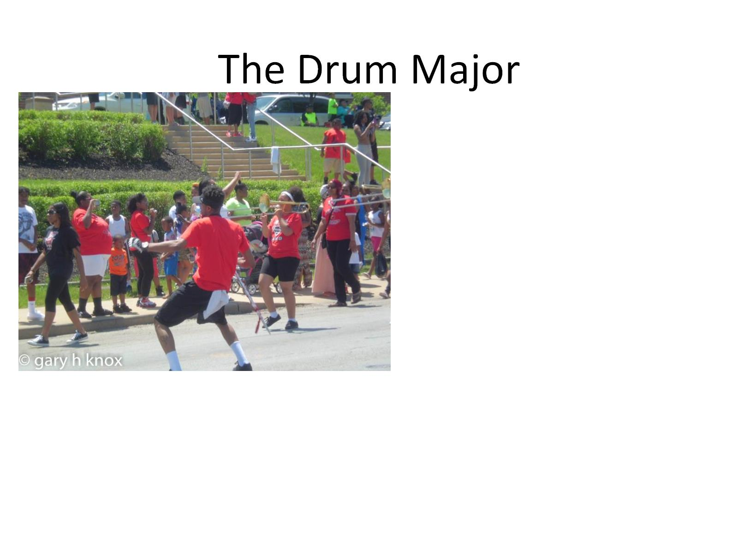
The Drum Major

Slide 13
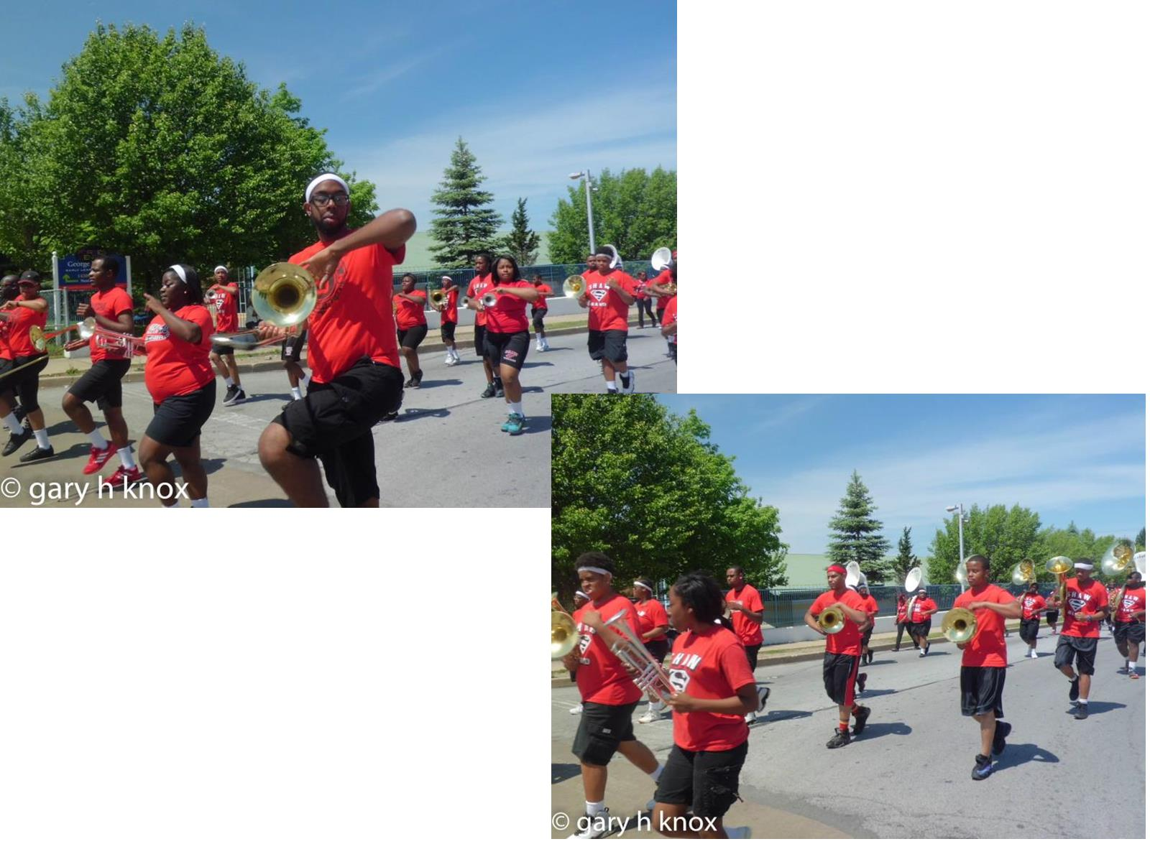

Slide 14
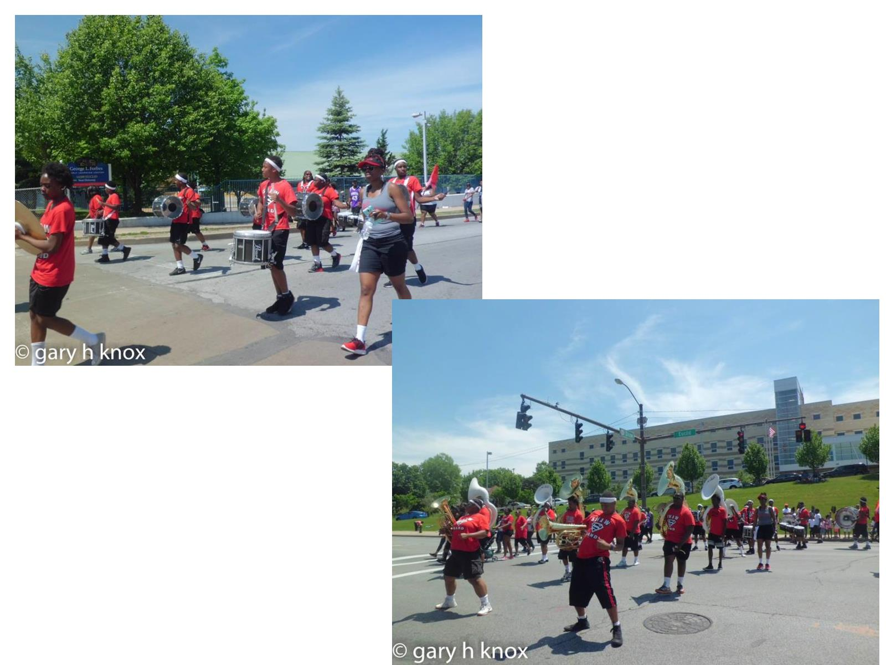

Slide 15
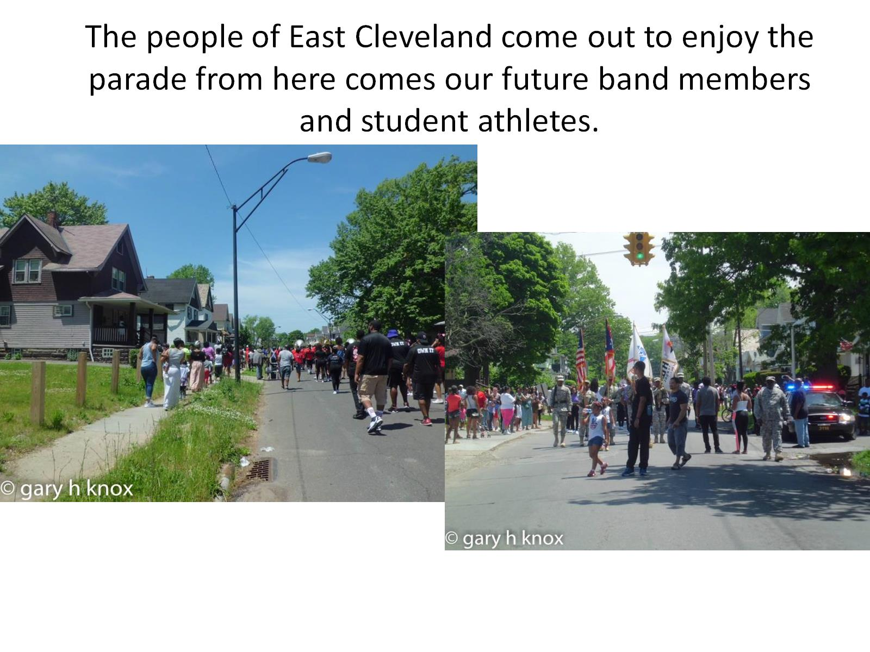
The people of East Cleveland come out to enjoy the parade from here comes our future band members and student athletes.

Slide 16
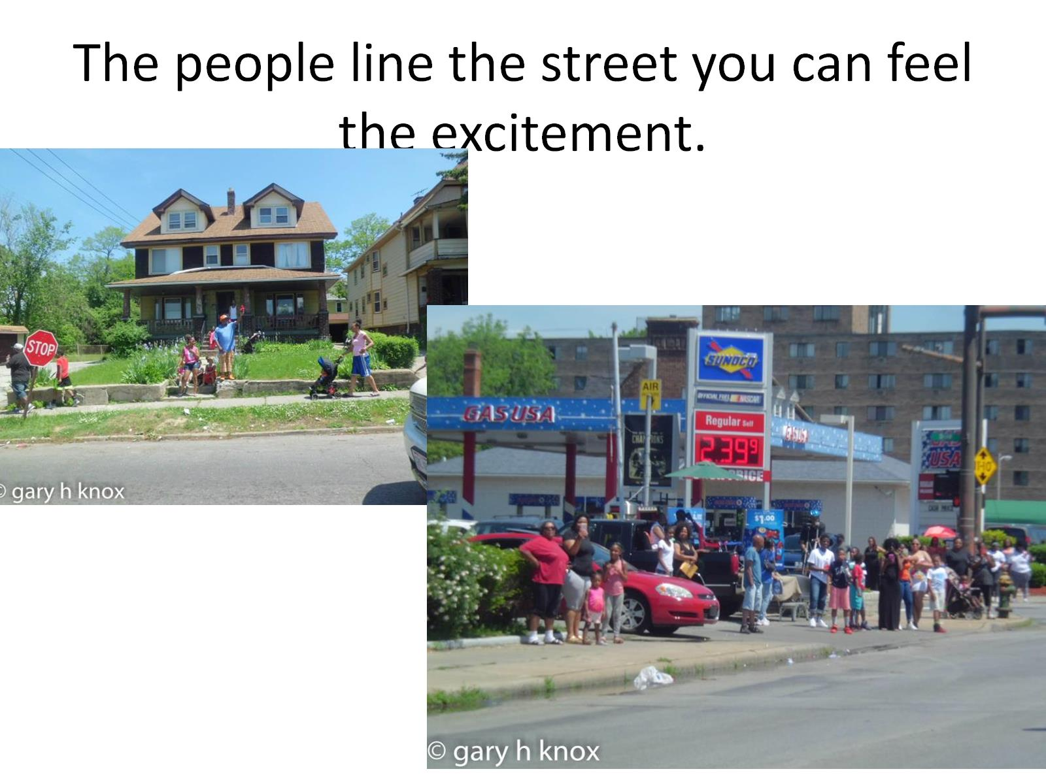
The people line the street you can feel the excitement.

Slide 17
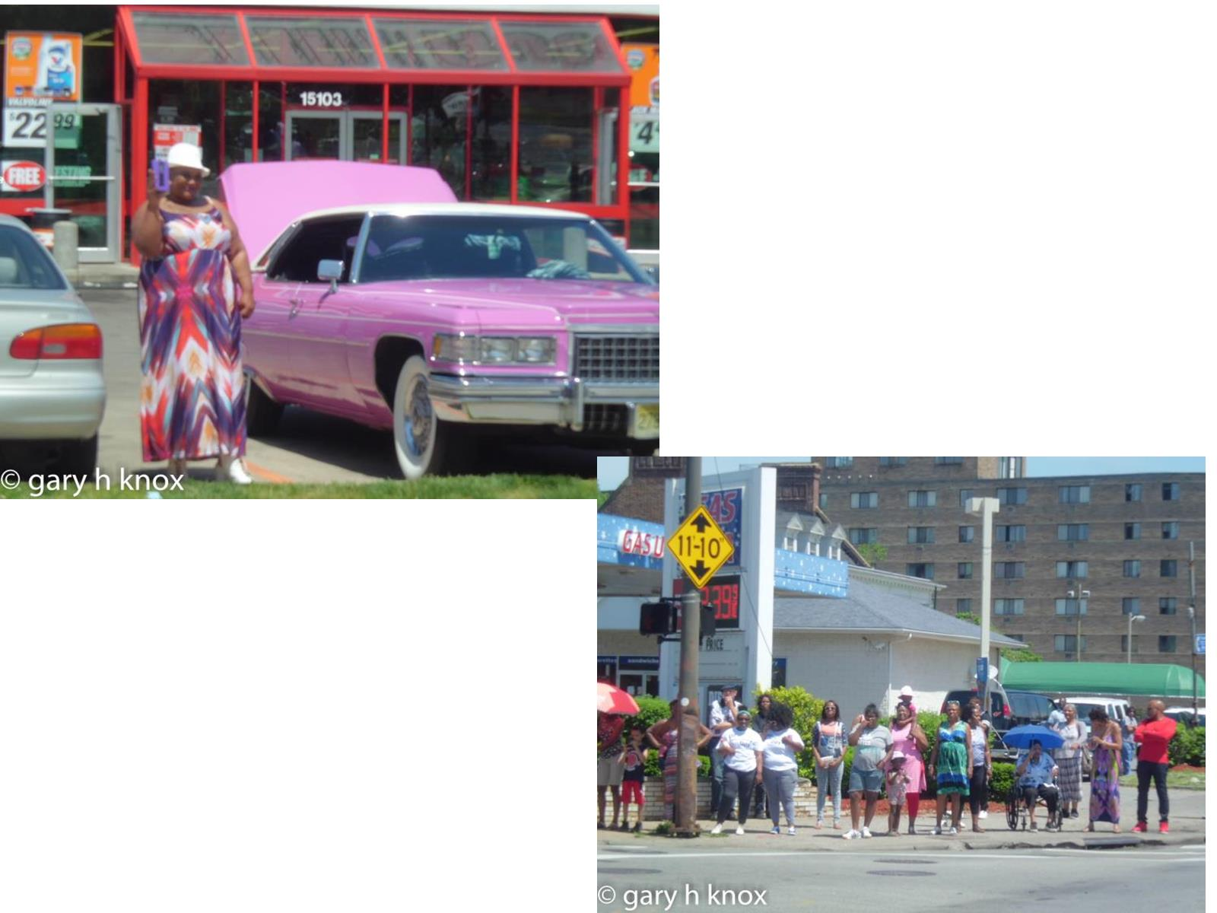

Slide 18
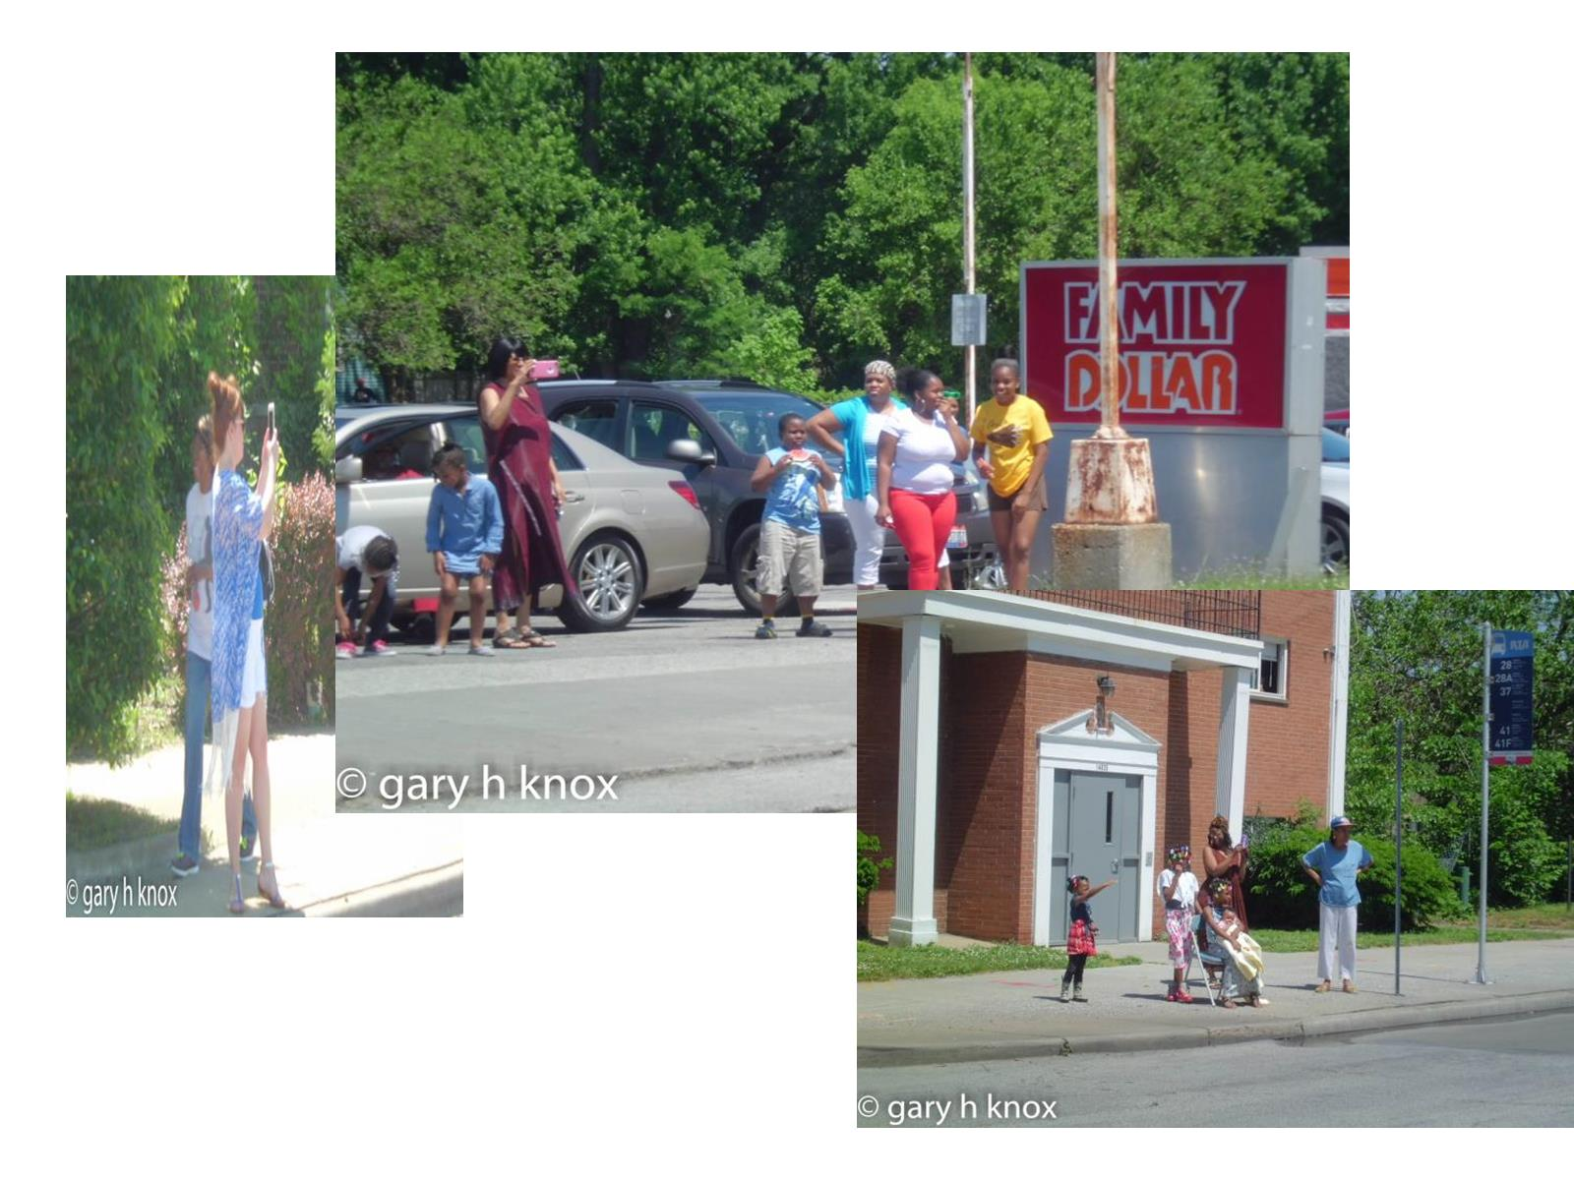

Slide 19
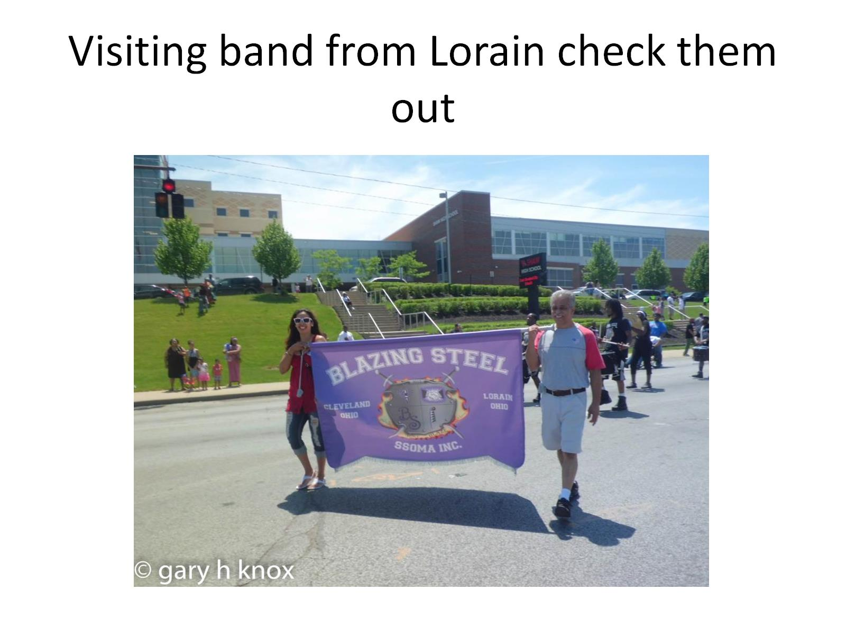
Visiting band from Lorain check them out

Slide 20
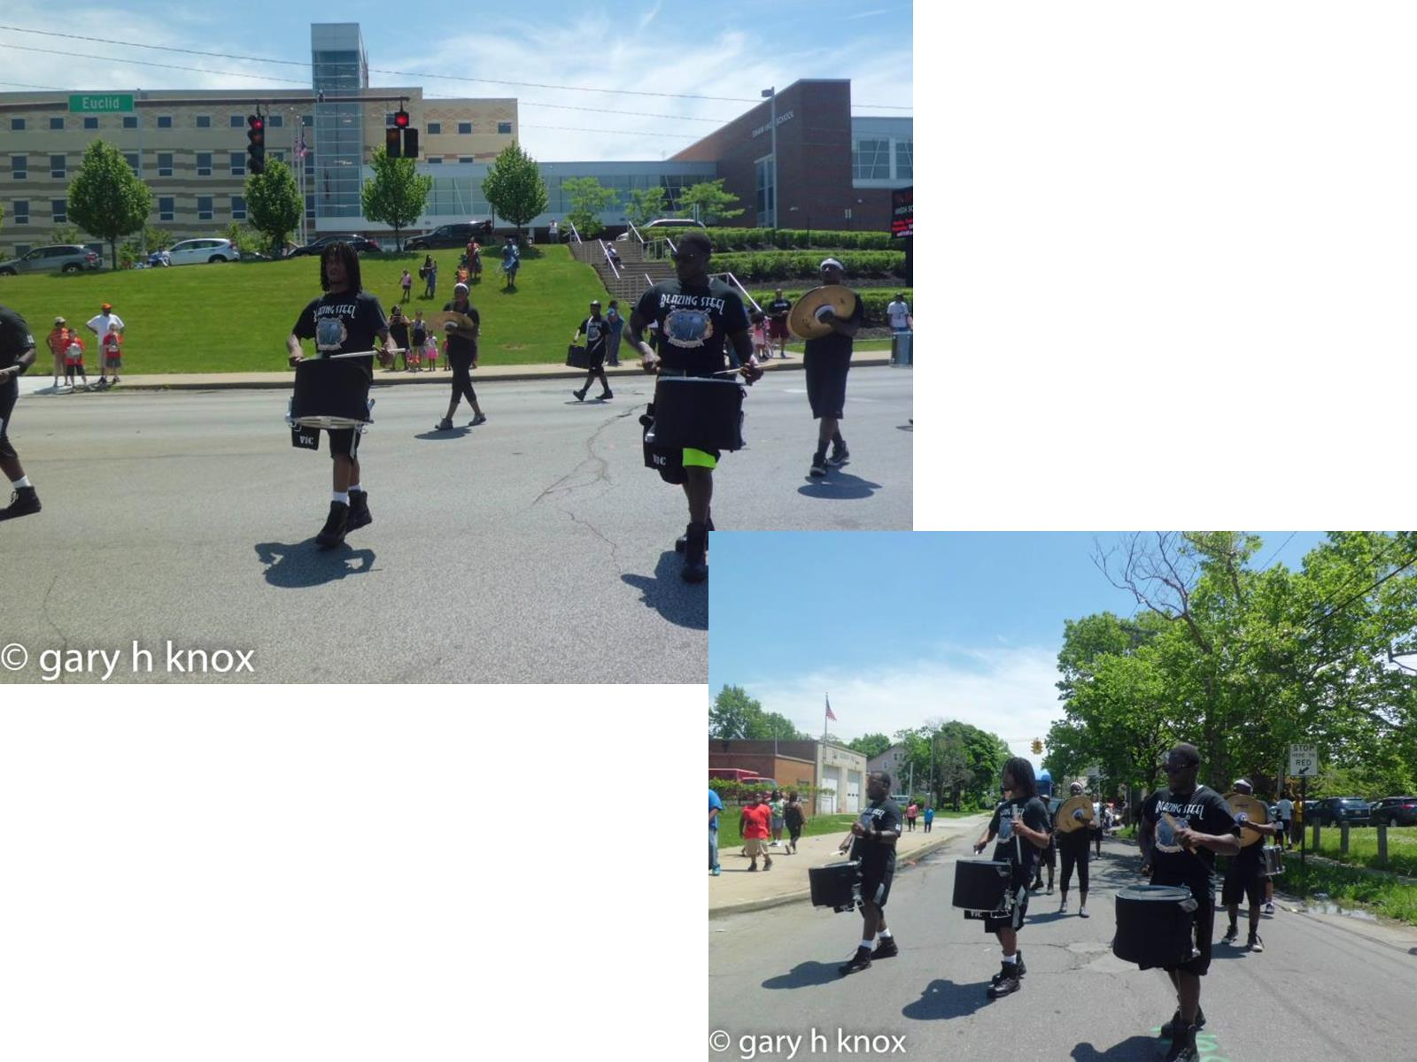

Slide 21
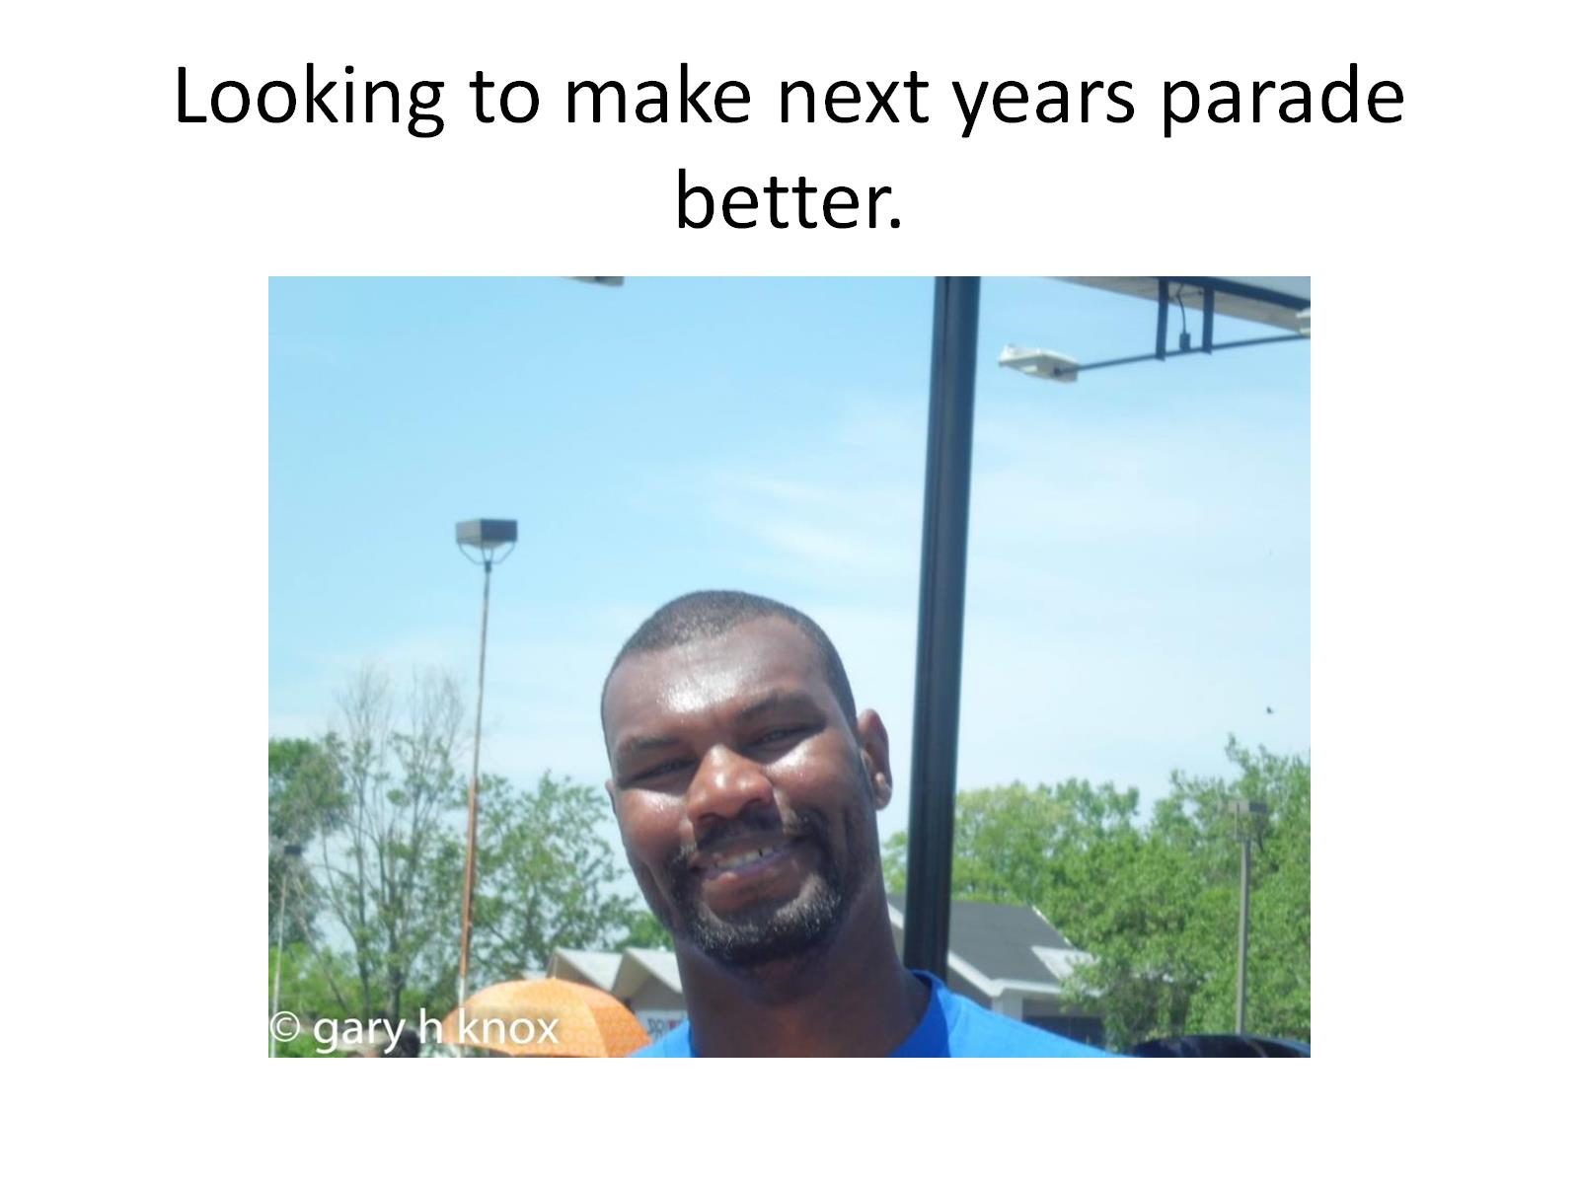
Looking to make next years parade better.

